Slide 1
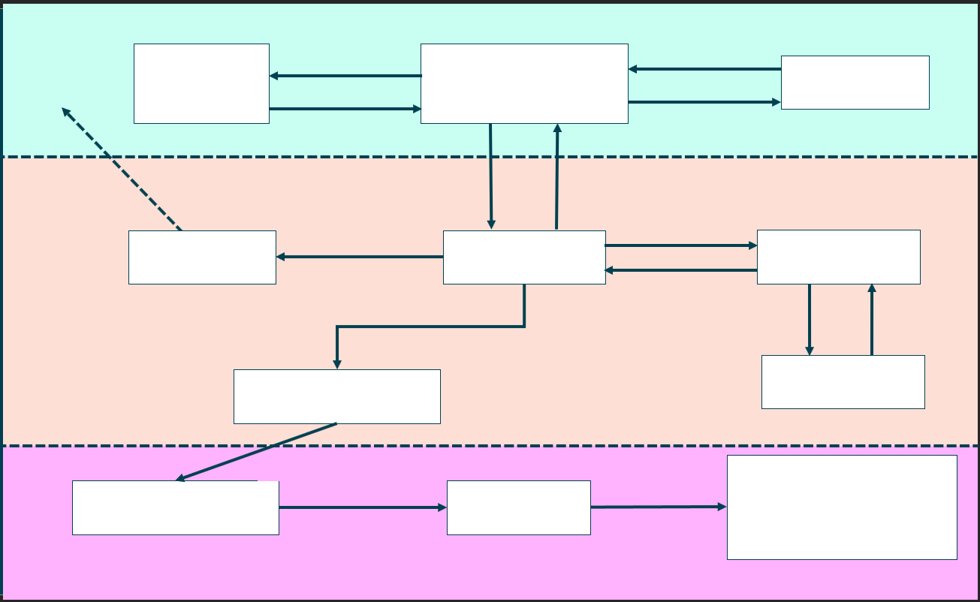

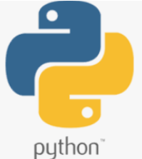
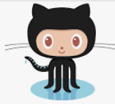




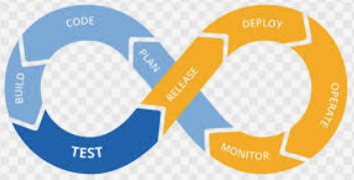

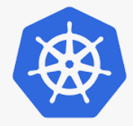
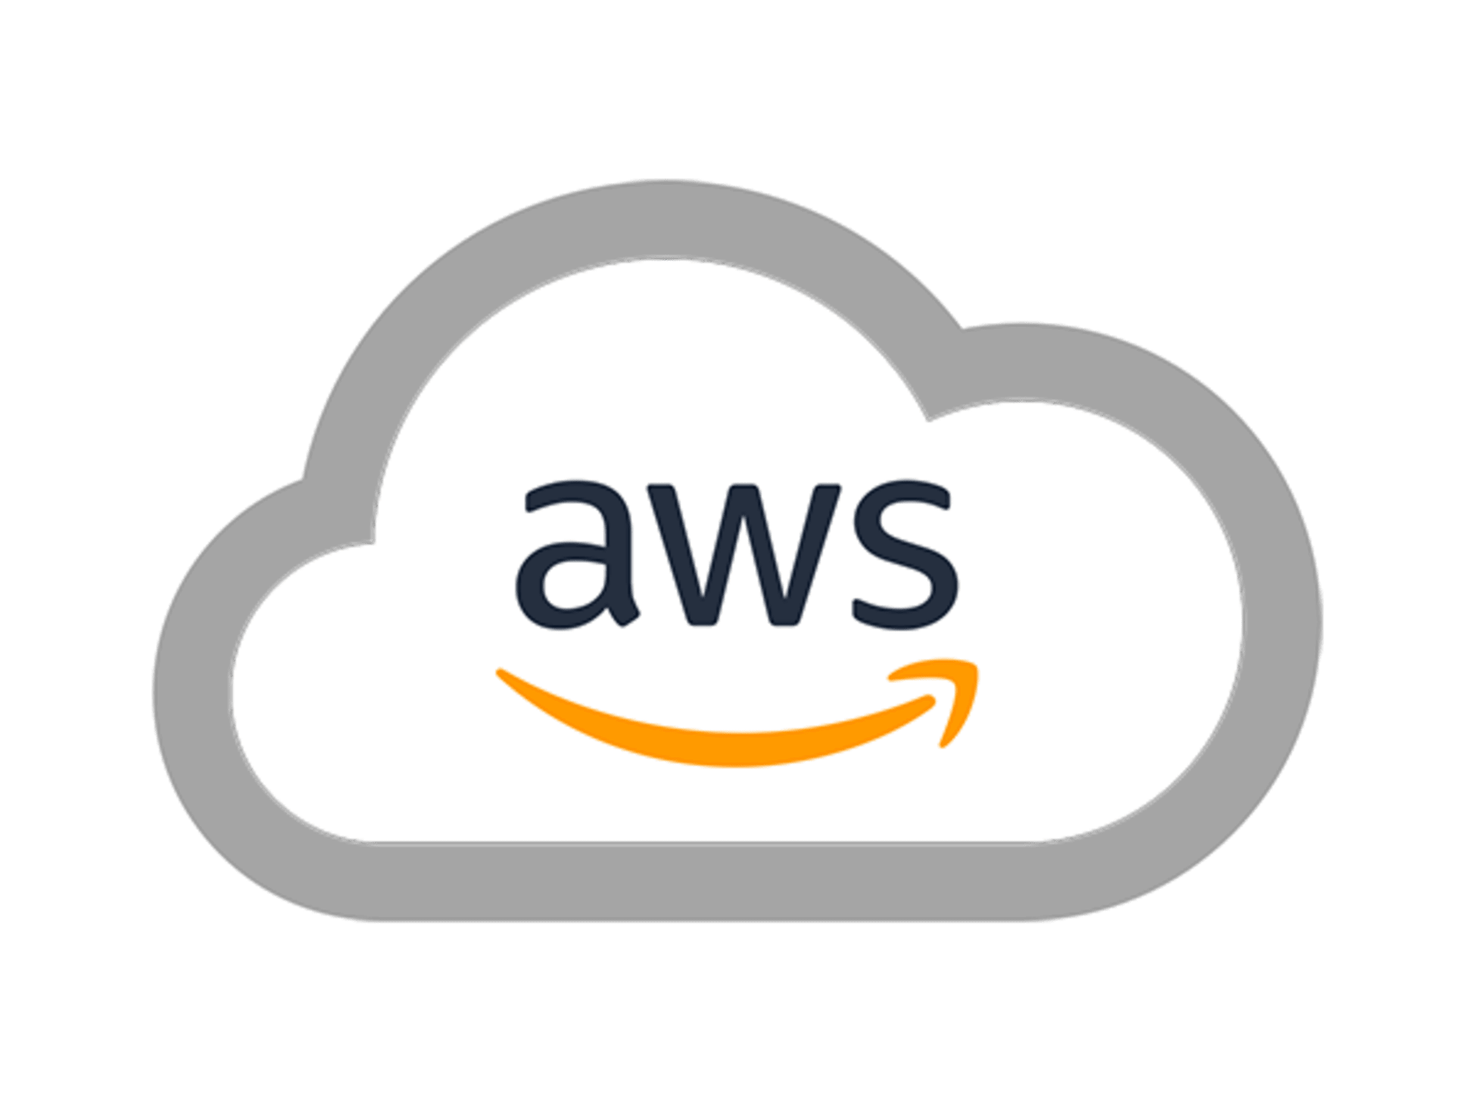



Pull
Version Control System
Get Work
Project Tracking
Source Code
Developers
Jira
GITHUB
Update Work
Push
Email the Devs
Pull Code
DEVOPS
Poll Code
Build Report
Send Code
Build Tool
Email Server
CI server
Travis
Build Results
Run Tests
Test Results
Send Artefact
Testing Tool
Artefact Repository
SELENIUM
Kubernetes
Test Artefact
Live Environment
Testing Environment
Staging Environment
Environment Testing Done
Staging Passed
AWS
Testers

